Slide 1

Language Translator

Slide 2
OBJECTIVES
Importance of Web Development.
Web Designer Vs. Web Development
Front-end and Back-end Development
HTML, CSS, JavaScript- An overview

Slide 3
IMPORTANCE OF WEB-DEVELOPMENT
The Internet is ubiquitous
Accessible through mobile and desktop.
Customers/users need to find your reputation.
Your websites is your first round-the-clock sales person!
The Website
Create first impression of your business.
Create it to suit the needs of your target audience.
Can bring business from any part of the world!
Web Development skill is needed to create a Website!

Slide 4
Web Designer Vs. Web Developer
A Web Designer
Designs the look and feel of a website (creative side of website)
Decides the layout, fonts, colour images and overall branding.
Creates the visual mock-up of the website.
A Right-brained(Creative) Person.
A Web Developer
Brings the website mock-up to life on the Internet(development side of websites)
Develops the website and hosts on a web server.
Has web Development skills: HTML,CSS,JAVASCRIPT,PHP,PERL,PYTHON,JAVA,RUBY.
A Left-brained(Logical) Person.
Gain Web Development skills to become a Web Developer

Slide 5
Front-end and Back-end Web Development
Front-End Web Development
Defined components on the page with HTML.
Make them look pleasing with CSS.
Enable interactivity with JavaScript.
Enhance productivity with use of frameworks.
Back-End Web Development
Create the page components and contents dynamically on the server.
Send the HTML+CSS+JAVASCRIPT to web browser(used by human user).
Generates pages by programming in Java, JavaScript, PHP, Python, Perl.
Aim to achieve fast response times to ed users.

Slide 6
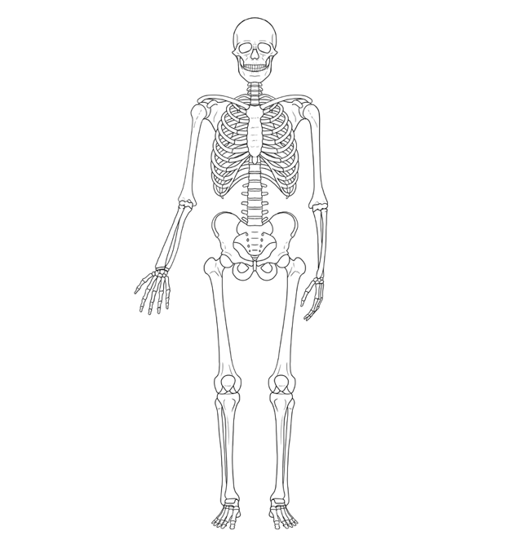
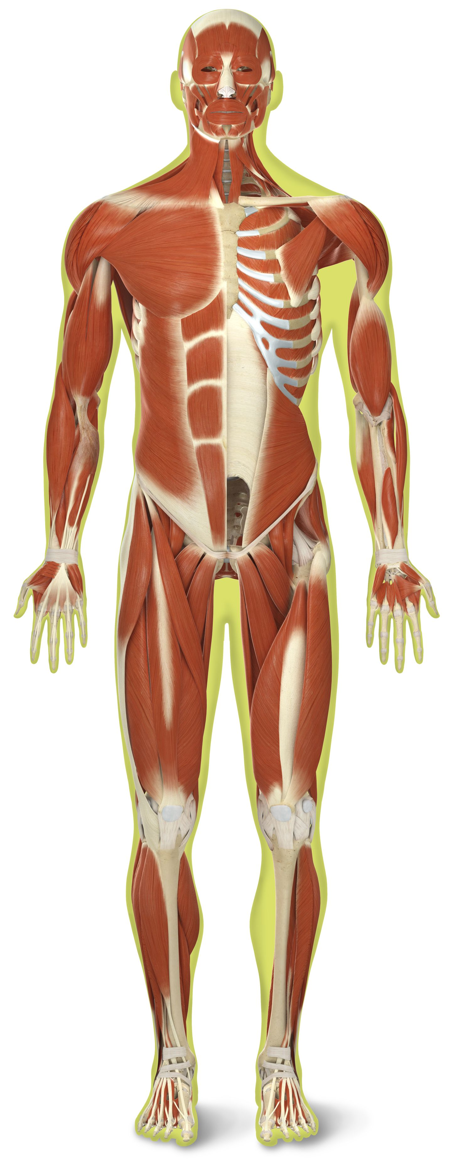

HTML,CSS and JAVASCRIPT-An Overview
HTML
Hypertext Markup Language
Structure of Page
JAVASCRIPT
Interactivity with user
Dynamic updates in a Web page
CSS
Cascading Style Sheets
Styling

Slide 7
Thank you…

